Slide 1

CSE211 COMPUTER ORGANIZATION AND DESIGN
Lecture #0

Slide 2
We Will Talk About
Course Details
Basic Terms of Computers
Basic Organization of Computers
Historical Perspective
About CSE 211
Why Take CSE 211
CSE 211 Implementation
Course Assessment Model
Course Content
Computer Architecture

Slide 3
Course details
LTP – 3 1 0
[Three lectures and One Tutorial/week]
Text Book
COMPUTER SYSTEM ARCHITECTURE by MORRIS MANO, Revised 3rd Edition, (2017)

Slide 4
Basic Terms
Digital
Digital Computers
Storage?
Base
Instruction
Program

Slide 5
What are the components of Computers?
Notes:
Hardware , Software (Application Software (Help to solve specific Problem) and System Software (More effective use of computer))

Slide 6
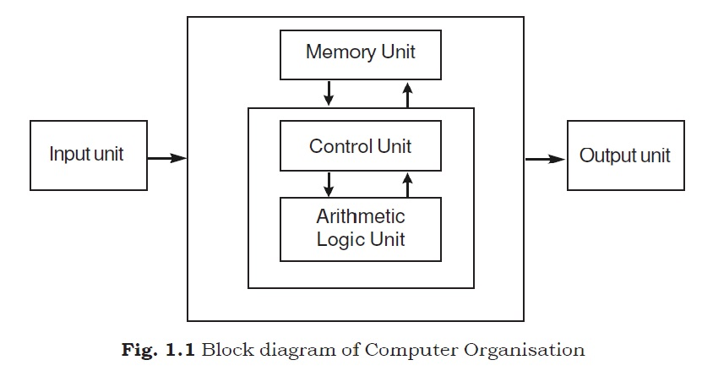
Basic Organization of a Computer

Slide 7
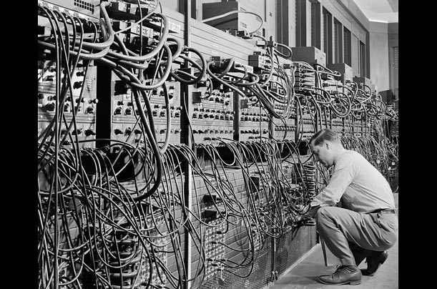
Historical Perspective
First generation Computers (1941-1956):

Slide 8
Characteristics
Vacuum Tubes
Magnetic Drums
Slow Operating Systems
Production of the heat
Machine language was used for programming
First generation computers were unreliable
They were difficult to program and use
*Von Neumann Computers

Slide 9
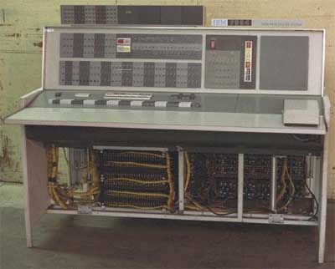
Second Generation Computers (1956-1963):

Slide 10
Characteristics
Use of transistors
Reliable in comparison to first generation computers
Smaller size as compared to first generation computers
Generated less heat as compared to first generation computers
Consumed less electricity as compared to first generation computers
Faster than first generation computers
Still very costly
AC required
Supported machine and assembly languages

Slide 11
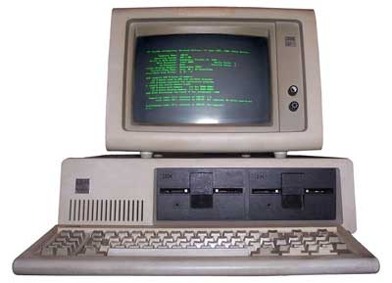
Third Generation Computers (1964-1971)

Slide 12
Characteristics
IC used
More reliable
Smaller size
Generated less heat
Consumed lesser electricity
Supported high-level language

Slide 13
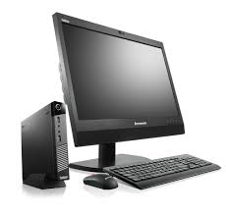
Fourth Generation (1971- Present)

Slide 14
Characteristics
VLSI technology used
Very cheap
Portable and reliable
Use of PCs
Very small size

Slide 15
Fifth Generation Computers (Present and Beyond)
Taking shape in advanced research laboratories
Artificial Intelligence
Massive parallel processing

Slide 16
About CSE 211
• Computer Architecture
• Computer Organization
• Computer Design

Slide 17
Why Take CSE211?
Core Subject
Embedded Programming
It can help you write better Code!
Proper Utilization of Resources
Essential to understand OS/Compiler
Fun!!!
• Who wouldn’t want to know the magician’s tricks?

Slide 18
CSE 211 Implementation
Lectures
Class Test/Quiz
Exams
Grades

Slide 19
Course Assessment Model
Marks break up*
Attendance 5
CA (All tests) 25
MTE 20
ETE 50
Total 100

Slide 20
The course contents
Basics Of Digital Electronics
Register Transfer and Micro Operations
Basic Computer Organization
Control Unit
Central Processing Unit
Computer Arithmetic
Input-Output Organization
Memory Unit
Introduction to Parallel Processing

Slide 21
Computer Architecture
“Architecture”
The art and science of designing and constructing buildings
A style and method of design and construction
Design, the way components fit together
Computer Architecture
The overall design or structure of a computer system, including the hardware and the software required to run it, especially the internal structure of the microprocessor

